Slide 1
July 25th Meeting
Ainsley Lai

Slide 2
Agenda
AIS Data
Method for interpolating and saving data
Rx Level for EC, CC, AB timeframe
Spectrograms
Default average_type was median before, switching to mean

Slide 3
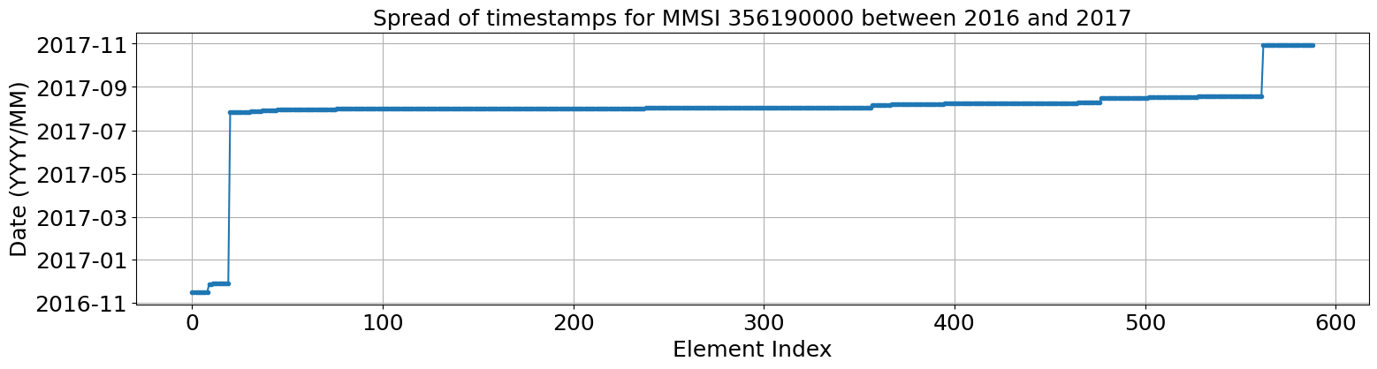
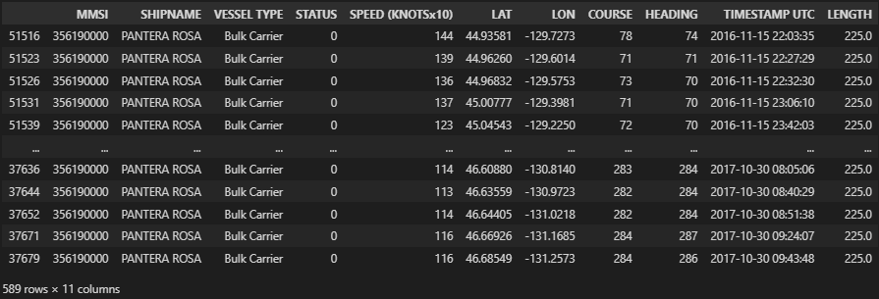
Method
Combine AIS data into singular dataframe
Take data from 2016-2017
Filter to one MMSI
356190000

Slide 4
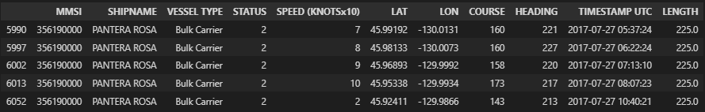
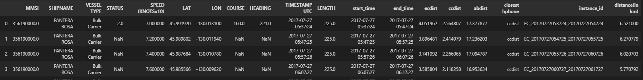
Method
For each hydrophone, filter to timeframes from before (+/- 3 hours)
Split up into 10-minute intervals for querying
(Linearly) interpolate timepoints in between existing timestamps to create more data
Calculate hydrophone distances and find closest
Add instance_id column for file searching
Add distance column using AIS Mapping code for range

Slide 5
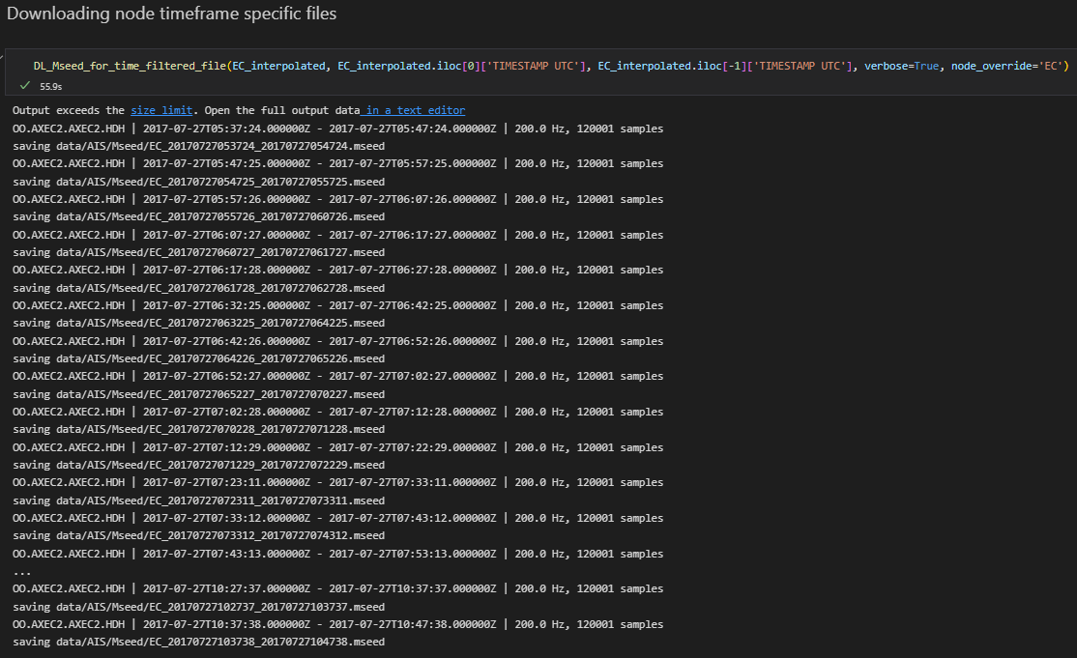
Method
Pass into general hydrophone querying function
Saves mseed and psd_pickle file
With those files downloaded, can calculate Rx levels

Slide 6
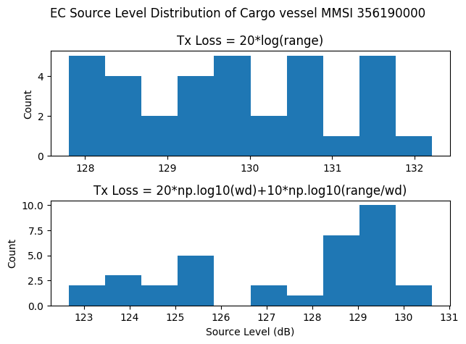
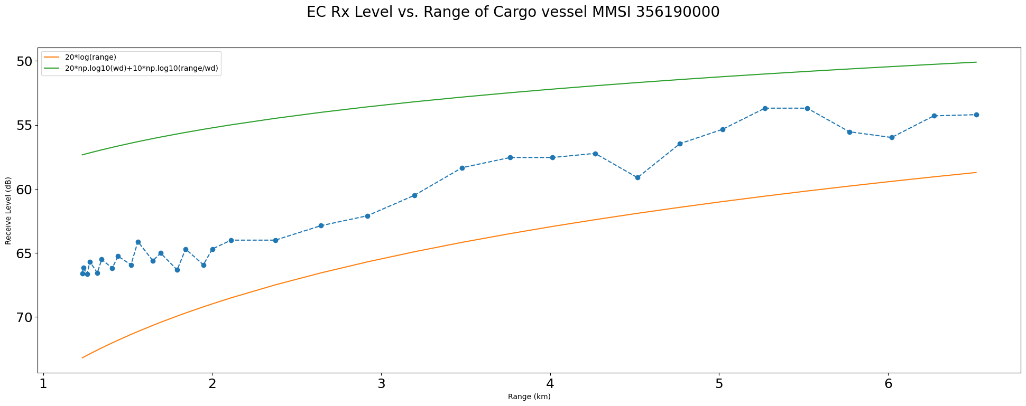
Eastern Caldera Rx Level

Slide 7
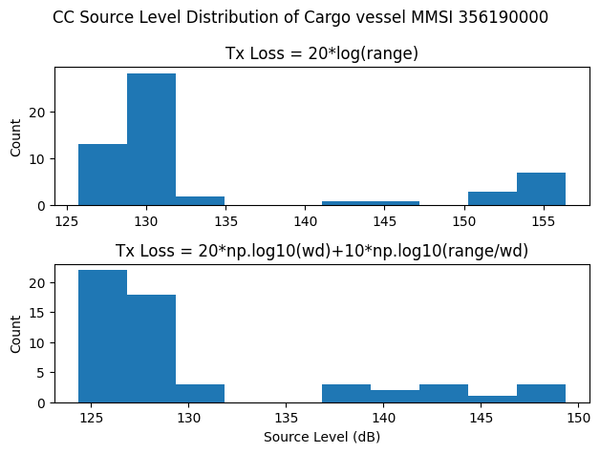
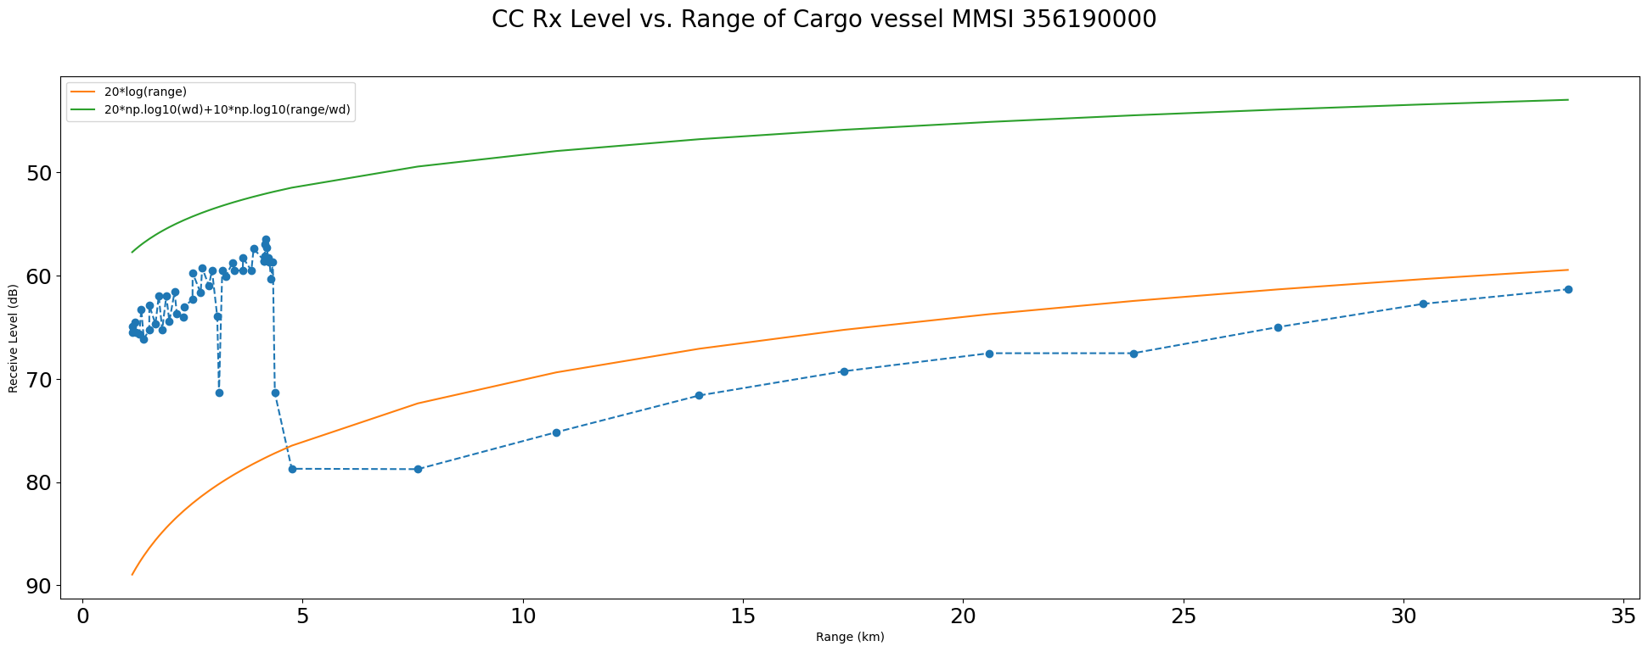
Central Caldera Rx Level

Slide 8
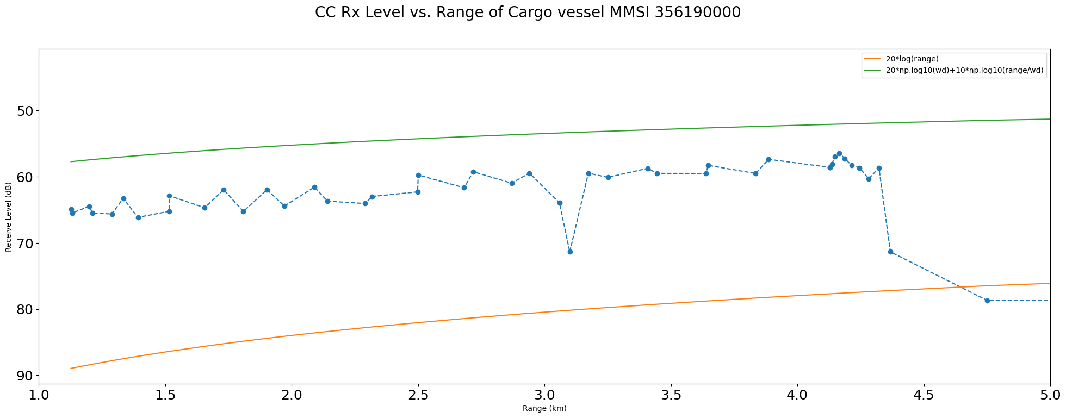
Central Caldera Rx Level
Only 2 of ‘real’ rows are more than 5 km away from hydrophone. Filtered to focus on closer range data

Slide 9
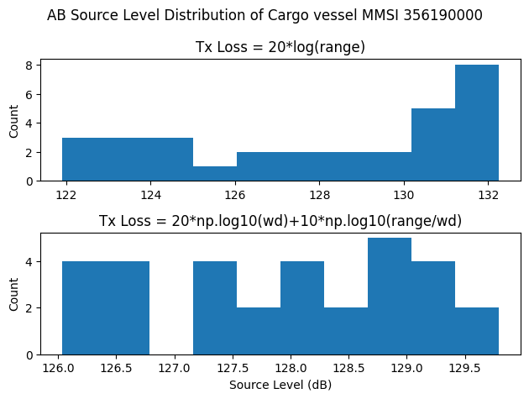
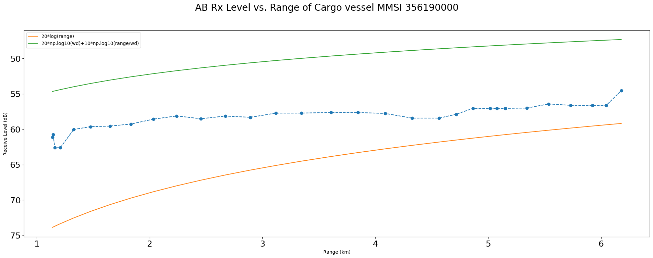
Axial Base Rx Level

Slide 10
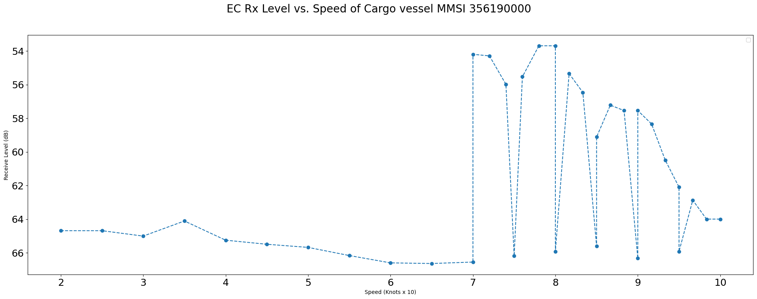
Eastern Caldera Rx Level

Slide 11
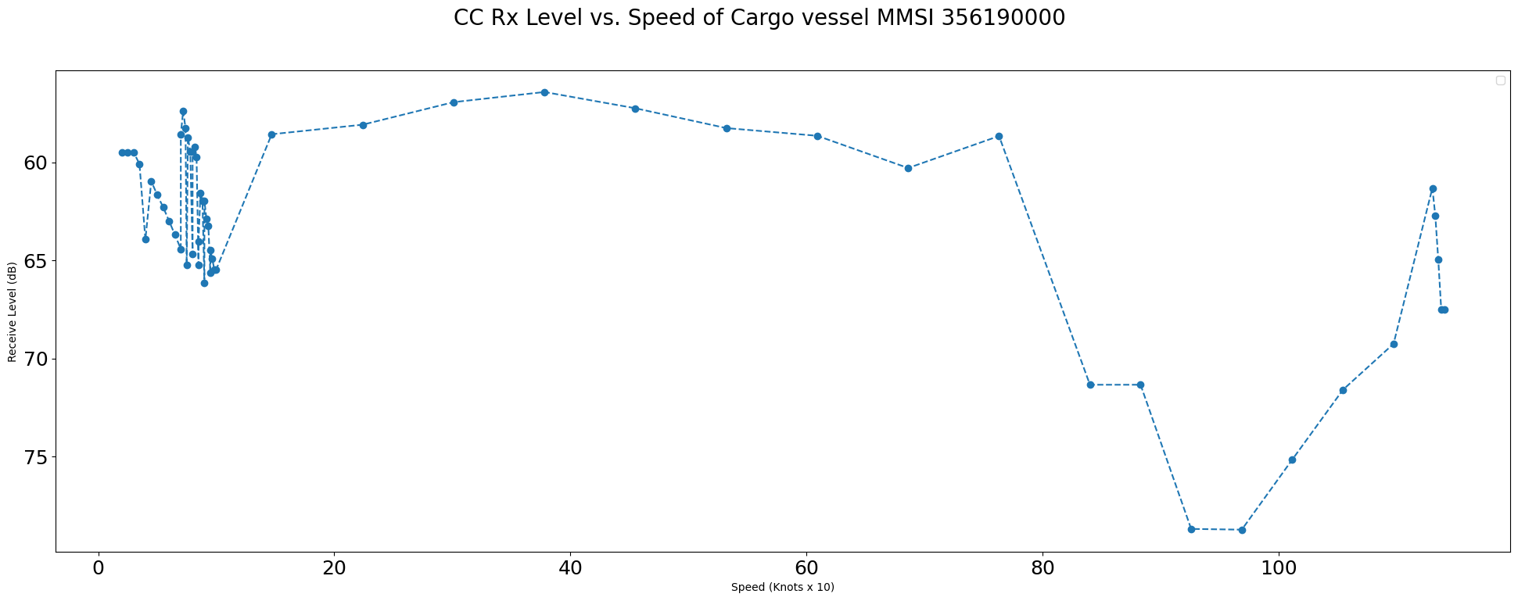
Central Caldera Rx Level

Slide 12
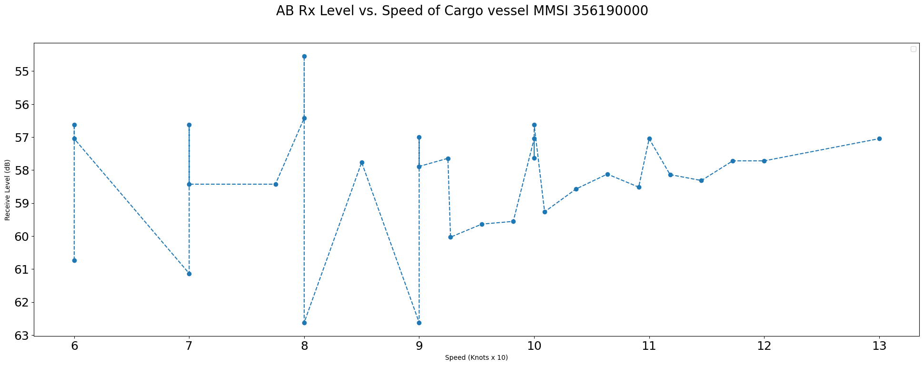
Axial Base Rx Level

Slide 13
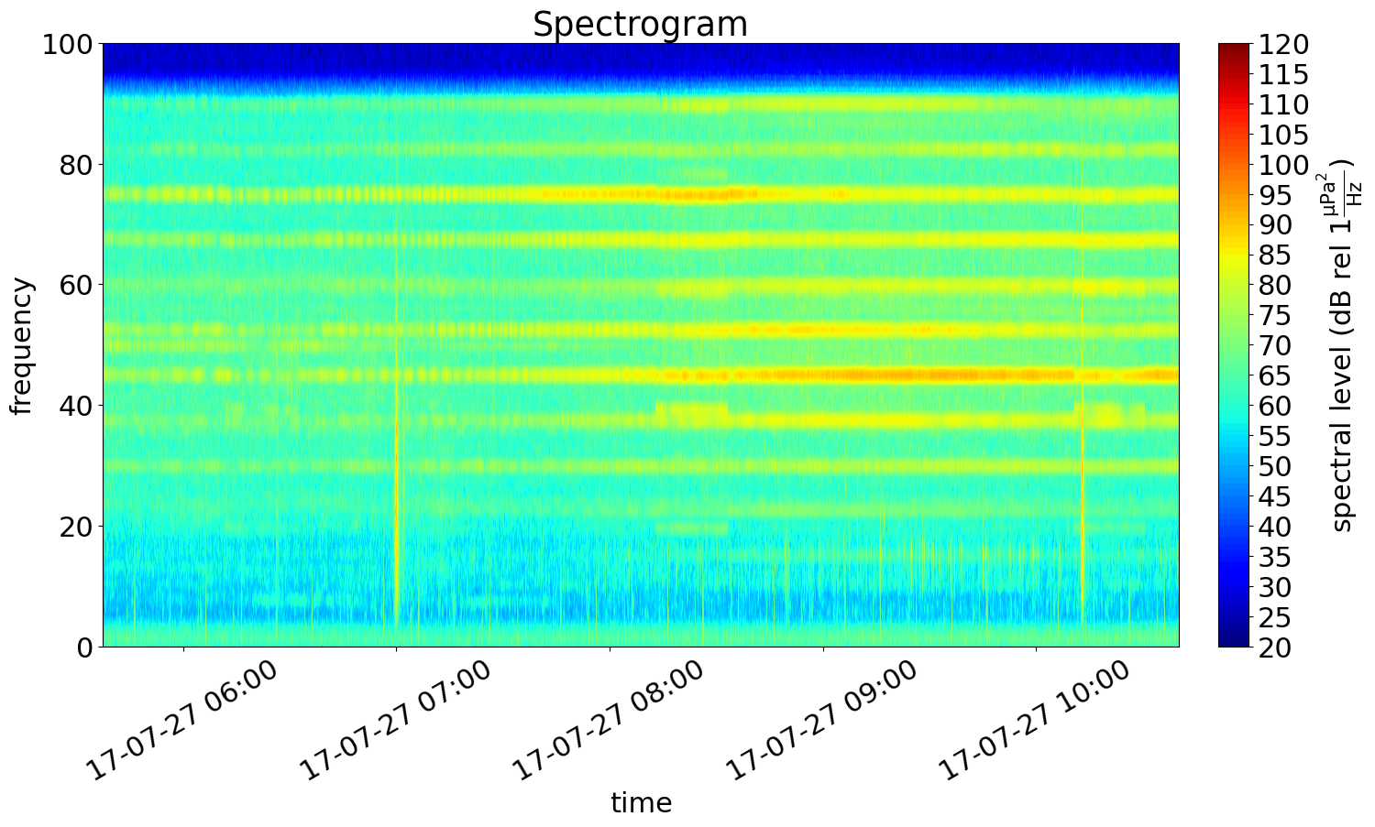
Spectrogram EC
Start: 07:13:10
End: 08:07:23

Slide 14
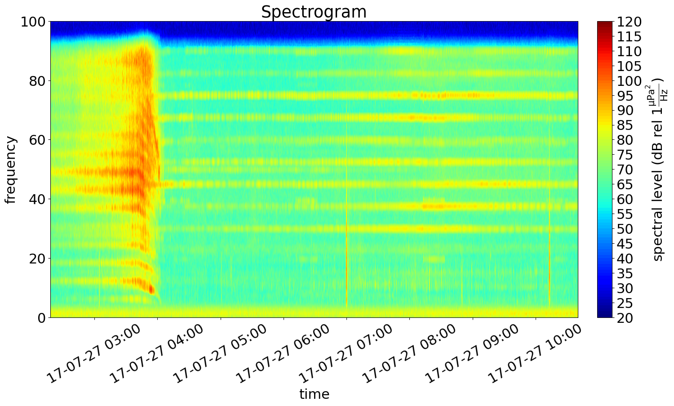
Spectrogram CC
Start: 04:02:56
End: 08:07:23

Slide 15
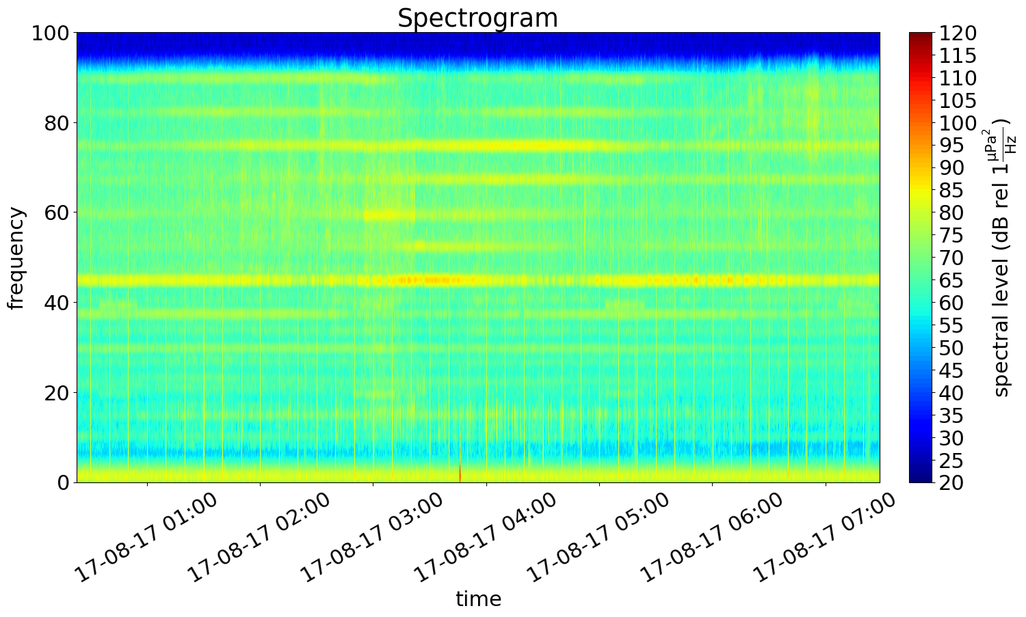
Spectrogram AB
Start: 03:22:52
End: 05:37:51

